Slide 1
Basics of Parallel Computing

Slide 2
Contents
What is Parallel Computing?
Why Use Parallel Computing?
Concepts and Terminology
Parallel Computer Memory Architectures

Slide 3
Serial Computing
Traditionally, software has been written for serial computation:
A problem is broken into a discrete series of instructions
Instructions are executed sequentially one after another
Executed on a single processor
Only one instruction may execute at any moment in time

Slide 4
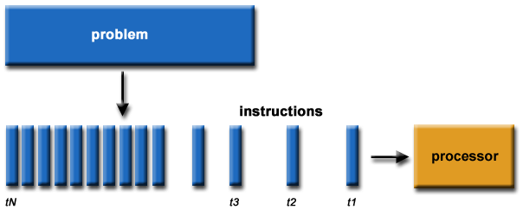
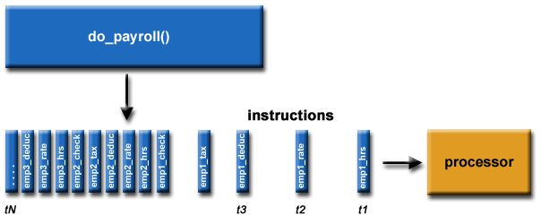

Slide 5
Parallel Computing
parallel computing is the simultaneous use of multiple compute resources to solve a computational problem:
A problem is broken into discrete parts that can be solved concurrently
Each part is further broken down to a series of instructions
Instructions from each part execute simultaneously on different processors
An overall control/coordination mechanism is employed

Slide 6
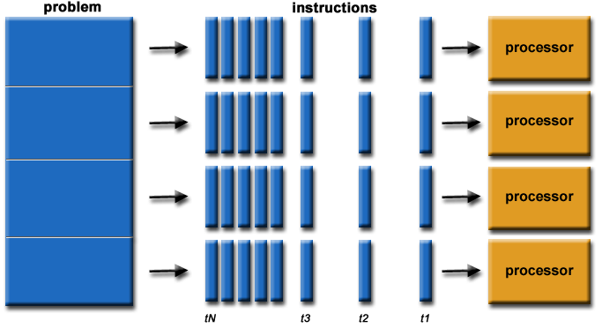
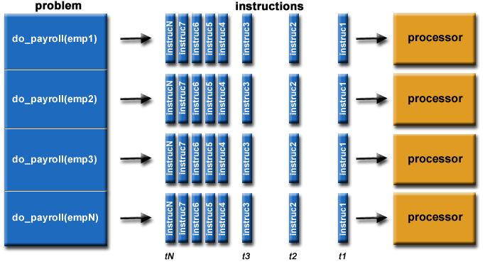

Slide 7
The computational problem should be able to:
Be broken apart into discrete pieces of work that can be solved simultaneously;
Execute multiple program instructions at any moment in time;
Be solved in less time with multiple compute resources than with a single compute resource.
The compute resources are typically:
A single computer with multiple processors/cores
An arbitrary number of such computers connected by a network

Slide 8
Parallel Computers
Virtually all stand-alone computers today are parallel from a hardware perspective:
Multiple functional units (L1 cache, L2 cache, branch, prefetch, decode, floating-point, graphics processing (GPU), integer, etc.)
Multiple execution units/cores
Multiple hardware threads

Slide 9
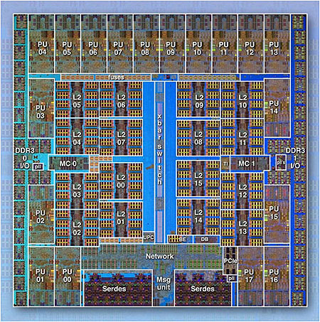
Fig: IBM BG/Q Compute Chip with 18 cores (PU) and 16 L2 Cache units (L2)

Slide 10
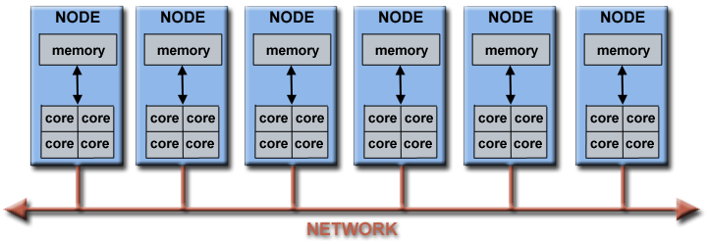
Networks connect multiple stand-alone computers (nodes) to make larger parallel computer clusters

Slide 11
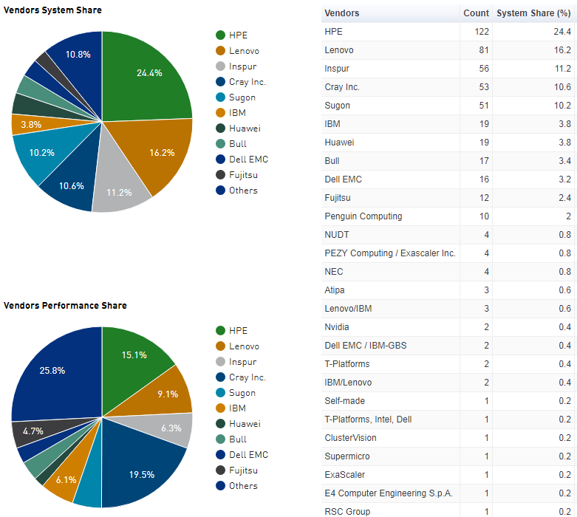
The majority of the world's large parallel computers (supercomputers) are clusters of hardware produced by a handful of (mostly) well known vendors

Slide 12
Why Use Parallel Computing?
The Real World is Massively Parallel:
In the natural world, many complex, interrelated events are happening at the same time, yet within a temporal sequence.
Compared to serial computing, parallel computing is much better suited for modeling, simulating and understanding complex, real world phenomena.

Slide 13

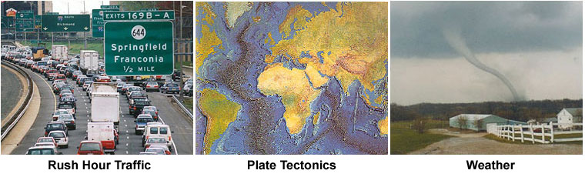
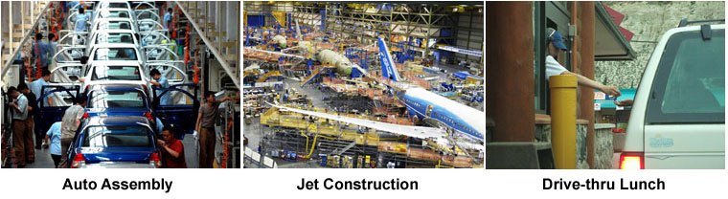

Slide 14
Main Reasons
SAVE TIME AND/OR MONEY:
In theory, throwing more resources at a task will shorten its time to completion, with potential cost savings.
Parallel computers can be built from cheap, commodity components.
SOLVE LARGER / MORE COMPLEX PROBLEMS:
Many problems are so large and/or complex that it is impractical or impossible to solve them on a single computer, especially given limited computer memory.
Example: Web search engines/databases processing millions of transactions every second

Slide 15
PROVIDE CONCURRENCY:
A single compute resource can only do one thing at a time. Multiple compute resources can do many things simultaneously.
Example: Collaborative Networks provide a global venue where people from around the world can meet and conduct work "virtually".
TAKE ADVANTAGE OF NON-LOCAL RESOURCES:
Using compute resources on a wide area network, or even the Internet when local compute resources are scarce or insufficient.
Example: SETI@home (setiathome.berkeley.edu)
Example: Folding@home (folding.stanford.edu)

Slide 16
MAKE BETTER USE OF UNDERLYING PARALLEL HARDWARE:
Modern computers, even laptops, are parallel in architecture with multiple processors/cores.
Parallel software is specifically intended for parallel hardware with multiple cores, threads, etc.
In most cases, serial programs run on modern computers "waste" potential computing power.

Slide 17
The future
During the past 20+ years, the trends indicated by ever faster networks, distributed systems, and multi-processor computer architectures (even at the desktop level) clearly show that parallelism is the future of computing.
In this same time period, there has been a greater than 500,000x increase in supercomputer performance, with no end currently in sight.
The race is already on for Exascale Computing!
Exaflop = 10¹⁸ calculations per second

Slide 18
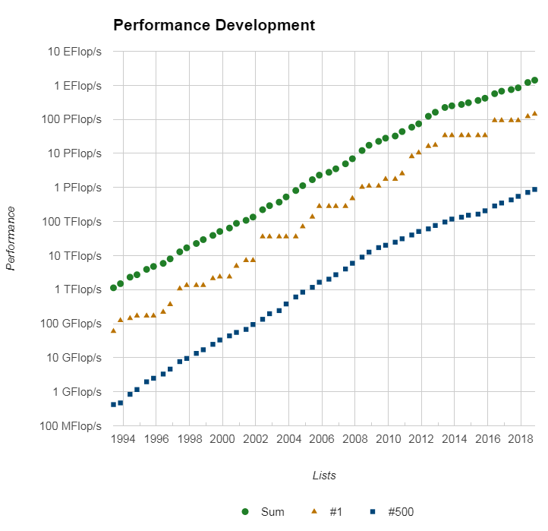

Slide 19
Who is Using Parallel Computing?
Science and Engineering:
parallel computing has been used to model difficult problems in many areas of science and engineering:
Atmosphere, Earth, Environment
Physics - applied, nuclear, particle, condensed matter, high pressure, fusion, photonics
Bioscience, Biotechnology, Genetics
Chemistry, Molecular Sciences
Geology, Seismology
Mechanical Engineering - from prosthetics to spacecraft
Electrical Engineering, Circuit Design, Microelectronics
Computer Science, Mathematics
Defence, Weapons

Slide 20
Industrial and Commercial:
These applications require the processing of large amounts of data in sophisticated ways.
"Big Data", databases, data mining
Artificial Intelligence (AI)
Web search engines, web based business services
Medical imaging and diagnosis
Pharmaceutical design
Financial and economic modeling
Management of national and multi-national corporations
Advanced graphics and virtual reality, particularly in the entertainment industry
Networked video and multi-media technologies
Oil exploration

Slide 21
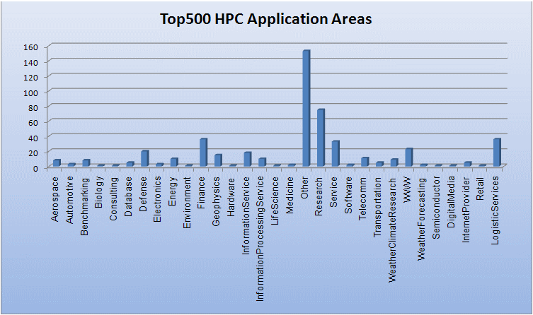
Global Applications
Parallel computing is now being used extensively around the world, in a wide variety of applications.

Slide 22
Concepts and Terminology
von Neumann Architecture
Hungarian mathematician/genius John von Neumann - requirements for an electronic computer (1945 papers)
Also known as "stored-program computer" - both program instructions and data are kept in electronic memory.
Differs from earlier computers which were programmed through "hard wiring".

Slide 23
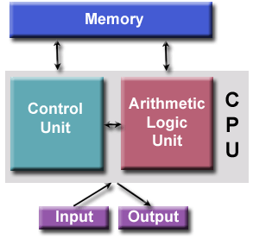
von Neumann Architecture - Comprised of four main components:
Memory
Control Unit
Arithmetic Logic Unit
Input/Output
NOTE: parallel computers still follow this basic design, just multiplied in units. The basic, fundamental architecture remains the same.

Slide 24
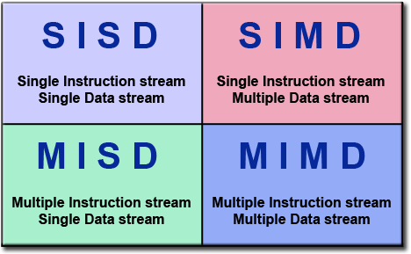
Flynn's Classical Taxonomy
Flynn's taxonomy distinguishes multi-processor computer architectures according to how they can be classified along the two independent dimensions of Instruction Stream and Data Stream. Each of these dimensions can have only one of two possible states: Single or Multiple.

Slide 25
Single Instruction, Single Data (SISD)
A serial (non-parallel) computer
Single Instruction: Only one instruction stream is being acted on by the CPU during any one clock cycle
Single Data: Only one data stream is being used as input during any one clock cycle
Deterministic execution
This is the oldest type of computer
Examples: older generation mainframes, minicomputers, workstations and single processor/core PCs. (UNIVAC1, IBM 360, CRAY1, CDC7600, PDP1, Dell Laptop)

Slide 26
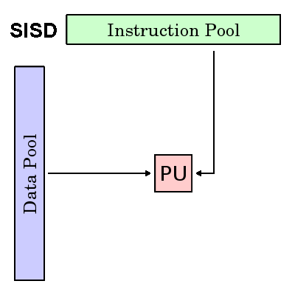
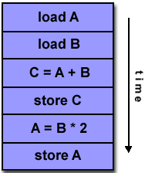

Slide 27
Single Instruction, Multiple Data (SIMD)
A type of parallel computer
Single Instruction: All processing units execute the same instruction at any given clock cycle
Multiple Data: Each processing unit can operate on a different data element
Best suited for specialized problems characterized by a high degree of regularity, such as graphics/image processing.
Synchronous (lockstep) and deterministic execution
Two varieties: Processor Arrays and Vector Pipelines
Examples:
Processor Arrays: Thinking Machines CM-2, MasPar MP-1 & MP-2, ILLIAC IV
Vector Pipelines: IBM 9000, Cray X-MP, Y-MP & C90, Fujitsu VP, NEC SX-2, Hitachi S820, ETA10
Most modern computers, particularly those with graphics processor units (GPUs) employ SIMD instructions and execution units.

Slide 28
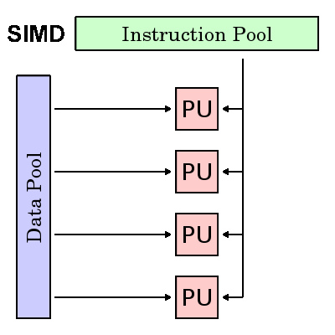
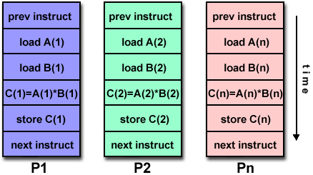
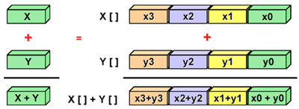

Slide 29
Multiple Instruction, Single Data (MISD)
A type of parallel computer
Multiple Instruction: Each processing unit operates on the data independently via separate instruction streams.
Single Data: A single data stream is fed into multiple processing units.
Few (if any) actual examples of this class of parallel computer have ever existed.
Some conceivable uses might be:
multiple frequency filters operating on a single signal stream
multiple cryptography algorithms attempting to crack a single coded message.

Slide 30
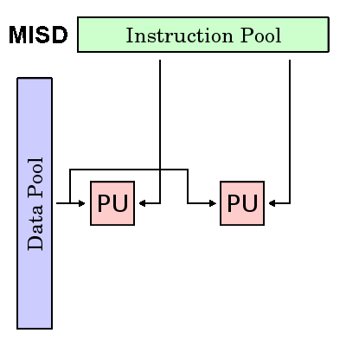
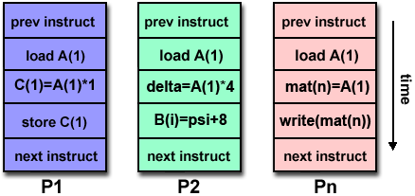

Slide 31
Multiple Instruction, Multiple Data (MIMD)
A type of parallel computer
Multiple Instruction: Every processor may be executing a different instruction stream
Multiple Data: Every processor may be working with a different data stream
Execution can be synchronous or asynchronous, deterministic or non-deterministic
Currently, the most common type of parallel computer - most modern supercomputers fall into this category.
Examples: most current supercomputers, networked parallel computer clusters and "grids", multi-processor SMP computers, multi-core PCs.
Note: many MIMD architectures also include SIMD execution sub-components

Slide 32
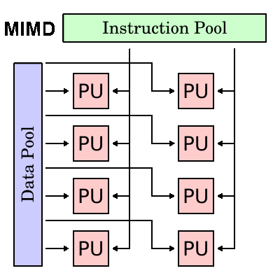
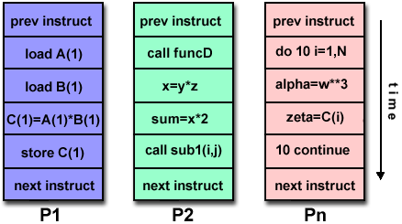

Slide 33
Some General Parallel Terminology
Supercomputing / High Performance Computing (HPC)
Node: A standalone "computer in a box". Usually comprised of multiple CPUs/processors/cores, memory, network interfaces, etc. Nodes are networked together to comprise a supercomputer.
CPU / Socket / Processor / Core
Task: A logically discrete section of computational work
Pipelining: Breaking a task into steps performed by different processor units, with inputs streaming through, much like an assembly line; a type of parallel computing

Slide 34
Shared Memory: a computer architecture where all processors have direct (usually bus based) access to common physical memory
Symmetric Multi-Processor (SMP): Shared memory hardware architecture where multiple processors share a single address space and have equal access to all resources
Distributed Memory: refers to network based memory access for physical memory that is not common
Communications: through a shared memory bus or over a network

Slide 35
Synchronization: The coordination of parallel tasks in real time, very often associated with communications.
Synchronization usually involves waiting by at least one task, and can therefore cause a parallel application's wall clock execution time to increase.
Granularity: In parallel computing, granularity is a qualitative measure of the ratio of computation to communication.
Coarse: relatively large amounts of computational work are done between communication events
Fine: relatively small amounts of computational work are done between communication events

Slide 36
Speedup:
speedup = time of serial execution / time of parallel execution
Parallel Overhead: The amount of time required to coordinate parallel tasks, as opposed to doing useful work. Parallel overhead can include factors such as:
Task start-up time
Synchronizations
Data communications
Software overhead imposed by parallel languages, libraries, operating system, etc.
Task termination time

Slide 37
Massively Parallel: Hardware having many processing elements. The meaning of "many" keeps increasing, but currently, the largest parallel computers having hundreds of thousands to millions “processing elements”.
Embarrassingly Parallel: Solving many similar, but independent tasks simultaneously -need for coordination between the tasks.
Scalability: ability to demonstrate a proportionate increase in parallel speedup. Factors that contribute to scalability include:
Hardware - particularly memory-cpu bandwidths and network communication properties
Application algorithm
Parallel overhead related
Characteristics of your specific application

Slide 38
Limits and Costs of Parallel Programming
Amdahl's Law: Amdahl's Law states that potential program speedup is defined by the fraction of code (P) that can be parallelized
Speedup = [ 1/ (1 - P) ]
If none of the code can be parallelized, P = 0 and the speedup = 1 (no speedup).
If all of the code is parallelized, P = 1 and the speedup is infinite (in theory).
If 50% of the code can be parallelized, maximum speedup = 2, meaning the code will run twice as fast.
Introducing the number of processors performing the parallel fraction of work, the relationship can be modelled by:
Speedup = [ 1/ (P/N + S) ]
where P = parallel fraction, N = number of processors and S = serial fraction.

Slide 39
It soon becomes obvious that there are limits to the scalability of parallelism.
Speedup
-------------------------------------
N P = .50 P = .90 P = .95 P = .99
----- ---------- --------- --------- ---------
10 1.82 5.26 6.89 9.17
100 1.98 9.17 16.80 50.25
1,000 1.99 9.91 19.62 90.99
10,000 1.99 9.91 19.96 99.02
100,000 1.99 9.99 19.99 99.90

Slide 40
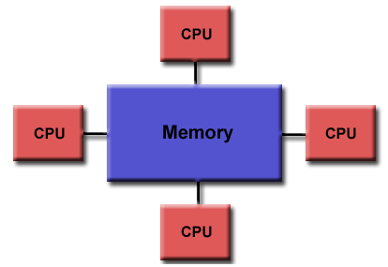
Parallel Computer Memory Architectures
Shared Memory : UMA , NUMA
Uniform Memory Access (UMA)
Most commonly represented today by Symmetric Multiprocessor (SMP) machines , identical processors
Sometimes called CC-UMA - Cache Coherent UMA. Cache coherent means if one processor updates a location in shared memory, all the other processors know about the update. Cache coherency is accomplished at the hardware level.

Slide 41
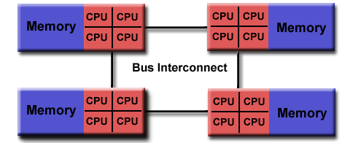
Non-Uniform Memory Access (NUMA)
Often made by physically linking two or more SMPs
One SMP can directly access memory of another SMP
Not all processors have equal access time to all memories
Memory access across link is slower
If cache coherency is maintained, then may also be called CC-NUMA - Cache Coherent NUMA

Slide 42
Advantages:
Global address space provides a user-friendly programming perspective to memory
Data sharing between tasks is both fast and uniform due to the proximity of memory to CPUs
Disadvantages:
Primary disadvantage is the lack of scalability between memory and CPUs. Adding more CPUs can geometrically increases traffic on the shared memory-CPU path, and for cache coherent systems, geometrically increase traffic associated with cache/memory management.
Programmer responsibility for synchronization constructs that ensure "correct" access of global memory.

Slide 43
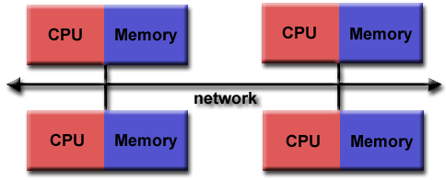
Distributed Memory
Distributed memory systems require a communication network to connect inter-processor memory.
Processors have their own local memory. No concept of global address space across all processors.
Processor has its own local memory, it operates independently. Hence, the concept of cache coherency does not apply.
When a processor needs access to data in another processor, it is usually the task of the programmer to explicitly define how and when data is communicated. Synchronization between tasks is likewise the programmer's responsibility.

Slide 44
Advantages:
Memory is scalable with the number of processors. Increase the number of processors and the size of memory increases proportionately.
Each processor can rapidly access its own memory without interference and without the overhead incurred with trying to maintain global cache coherency.
Cost effectiveness: can use commodity, off-the-shelf processors and networking.
Disadvantages:
Programmer is responsible for data communication between processors.
It may be difficult to map existing data structures, based on global memory, to this memory organization.
Non-uniform memory access times - data residing on a remote node takes longer to access than node local data.

Slide 45
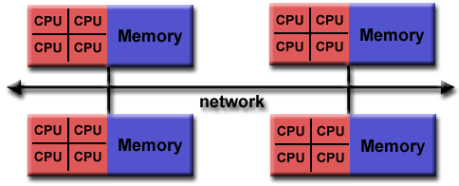
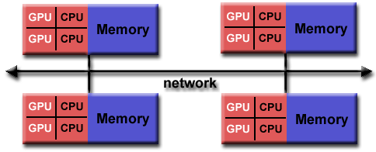
Hybrid Distributed-Shared Memory
The largest and fastest computers in the world today employ both shared and distributed memory architectures.
The shared memory component can be a shared memory machine and/or graphics processing units (GPU).
The distributed memory component is the networking of multiple shared memory/GPU machines, which know only about their own memory - not the memory on another machine. Therefore, network communications are required to move data from one machine to another.

Slide 46
Advantages and Disadvantages:
Whatever is common to both shared and distributed memory architectures.
Increased scalability is an important advantage
Increased programmer complexity is an important disadvantage

